Slide 1
BIFX 551 Advanced Data Analytics Programming with R
Week 9 – Spatial Data

Slide 2
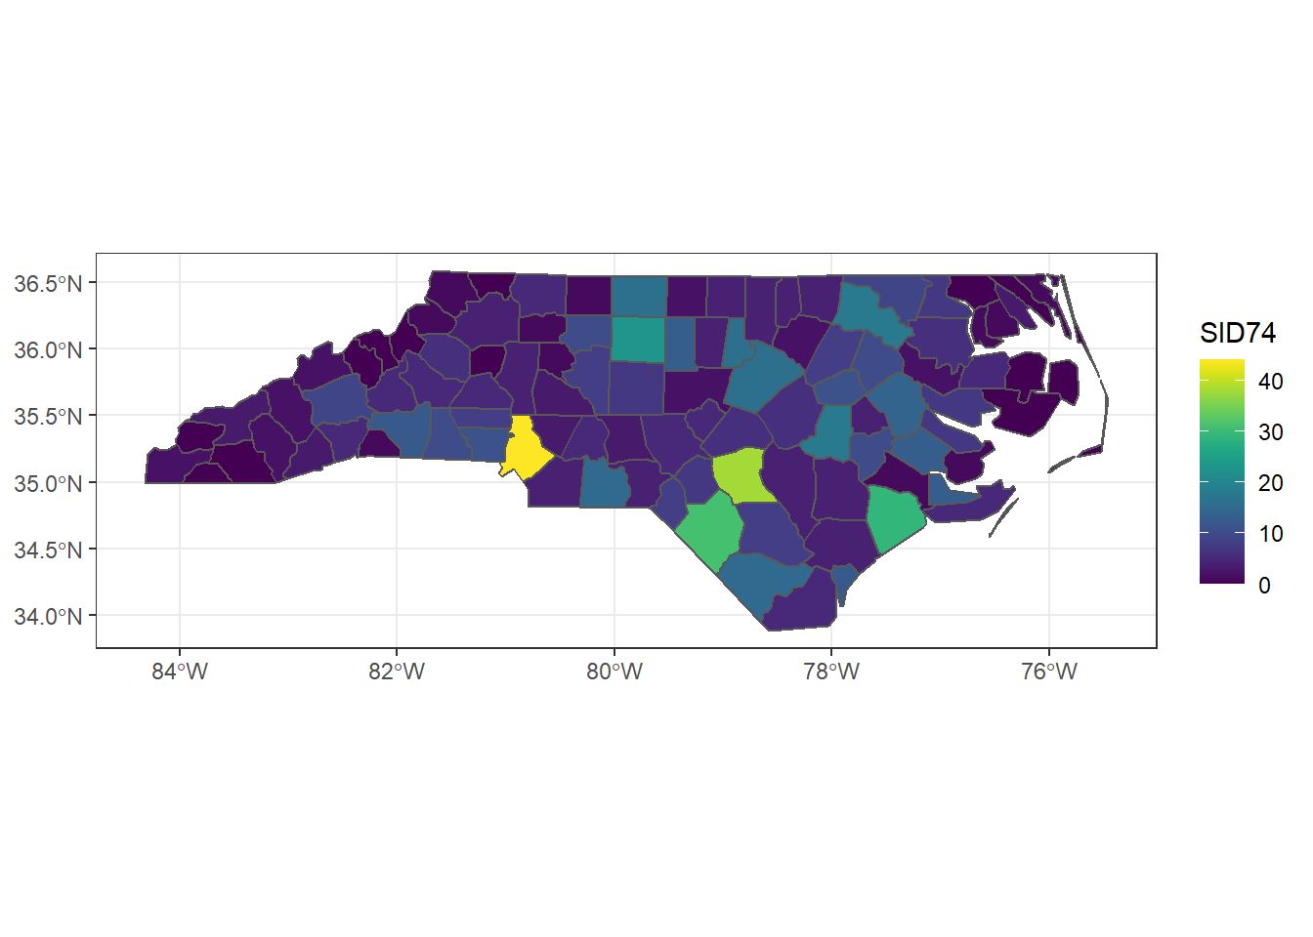
What is Spatial data?
Also referred to as geographic data or geospatial data, spatial data is any type of data that directly or indirectly references a specific geographical area or location.

Slide 3
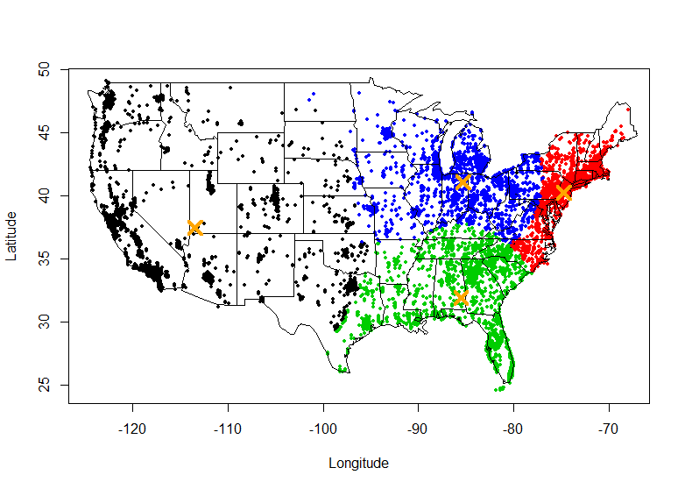
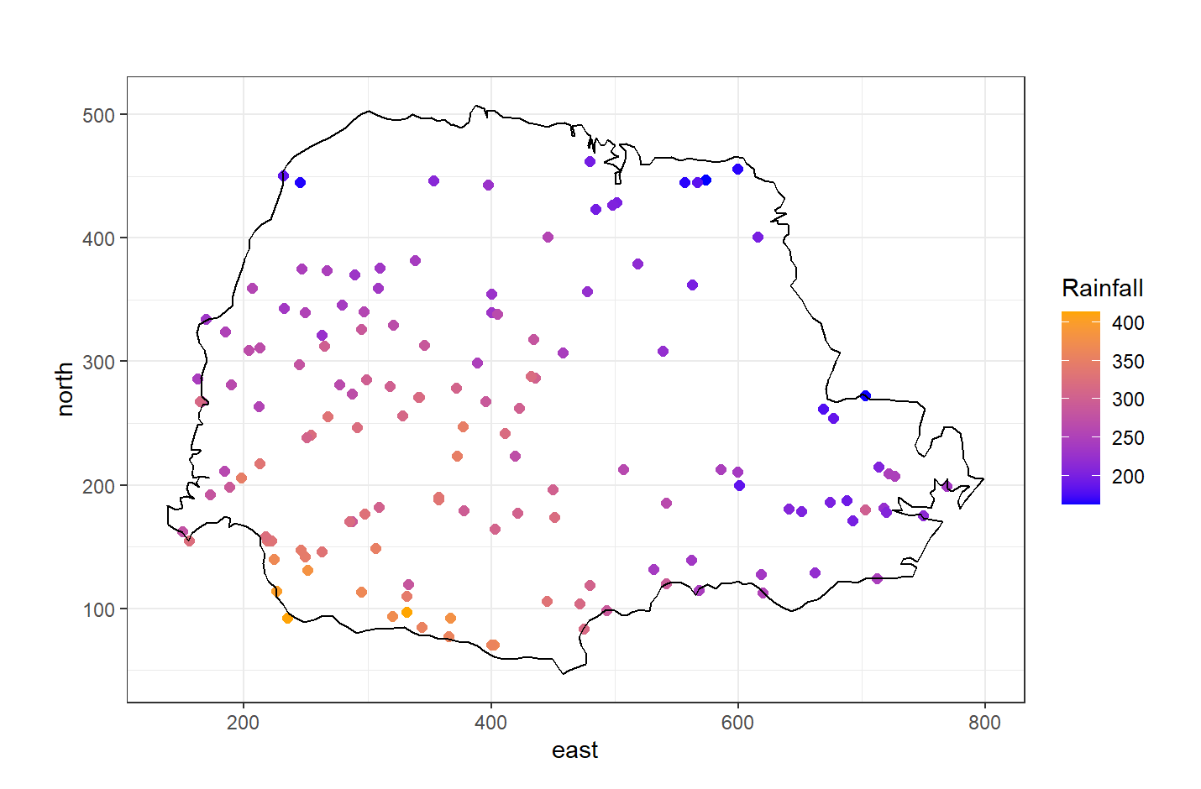
Why is this useful?
Sometimes it is useful to plot things based off of geographical information to see if the location plays a part in the data.
For example, if you wanted to visualize annual rainfall and you could see if mountain ranges effected the amount rain. Or if you wanted to track the movement of something over time.
This combined with clustering is often a useful tool

Slide 4
How to get started?
Investigate how polygons are drawn using ggplot.
Investigate how ST and SF data are used

Slide 5
Useful Links
Maps package
https://www.rdocumentation.org/packages/maps/versions/3.4.2
https://cran.r-project.org/web/packages/maps/maps.pdf
Spatial Data R book
https://r-spatial.org/book/
Leaflet
https://rstudio.github.io/leaflet/

